Slide 1


US Disaster Coverage Communication
Fall 2021
Cloud Computing (Group 1)
David English,
Ujjwal Oli,
Meron Metaferia

Slide 2




Scope of the Project
Based on FEMA website data
Informs us about the counties that are impacted by natural or man-made disasters
Determine eligibility for numerous government funding programs or benefits
Goal of the project:
Use of AWS services to connect to FEMA data
Use of AWS services to host the website for visualization
Mostly use of AWS basic tier services

Slide 3





Features of the project
Utilize ELB to minimize downtime
Utilizes EC2 in different AZ’s to maintain high availability
IAM roles allow us to limit access to code/data
EC2 User
DB User
S3 User
Use of S3 host our website and data
Load data into permanent database for ease of querying

Slide 4
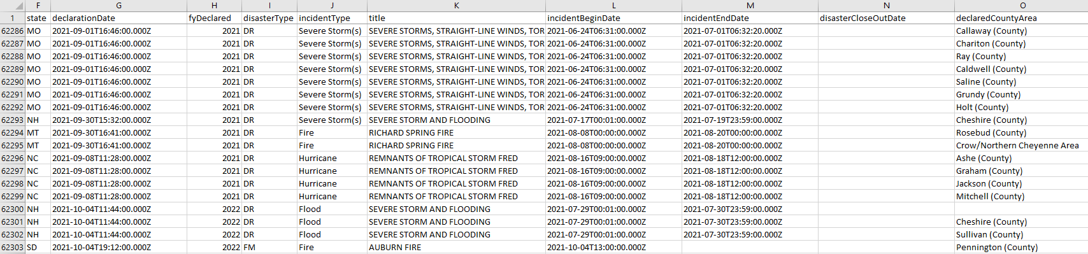
Data Sources
The primary data source for our project will be the list of disaster counties available at:
https://www.fema.gov/openfema-data-page/disaster-declarations-summaries-v1

Slide 5

Expected Outcomes
Website should contain geographical map of US showing counties
User should be able to access the website from anywhere
Currently available counties will be visually different from the one that has been impacted by a disaster by FEMA
An AWS framework that allows for easy updating of the site every time FEMA updates their list of disasters

Slide 6

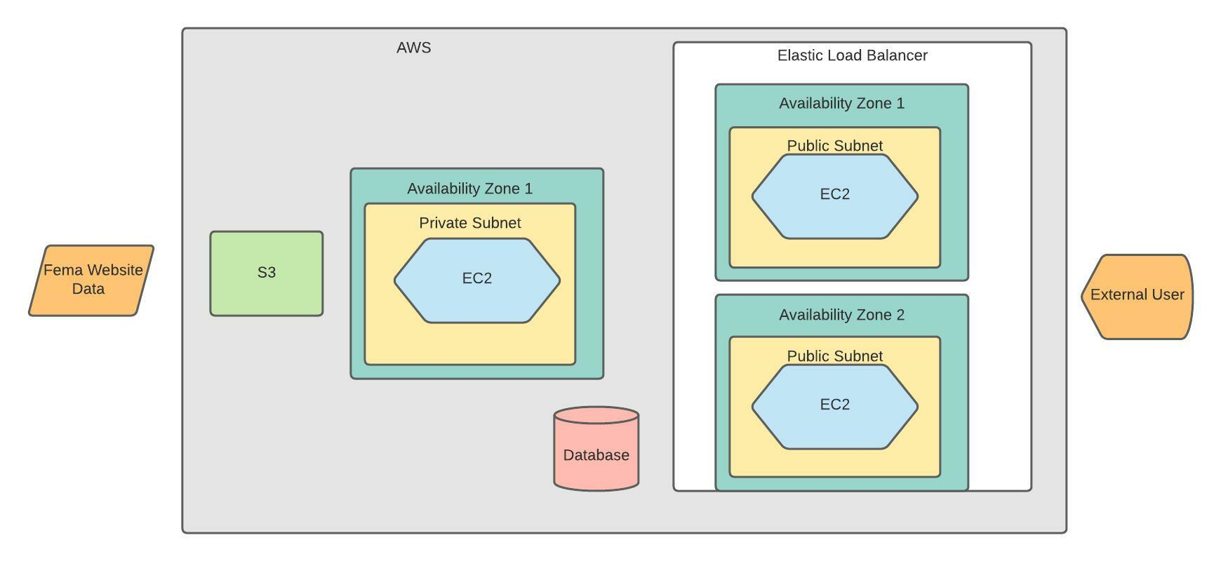
Logical Architecture

Slide 7

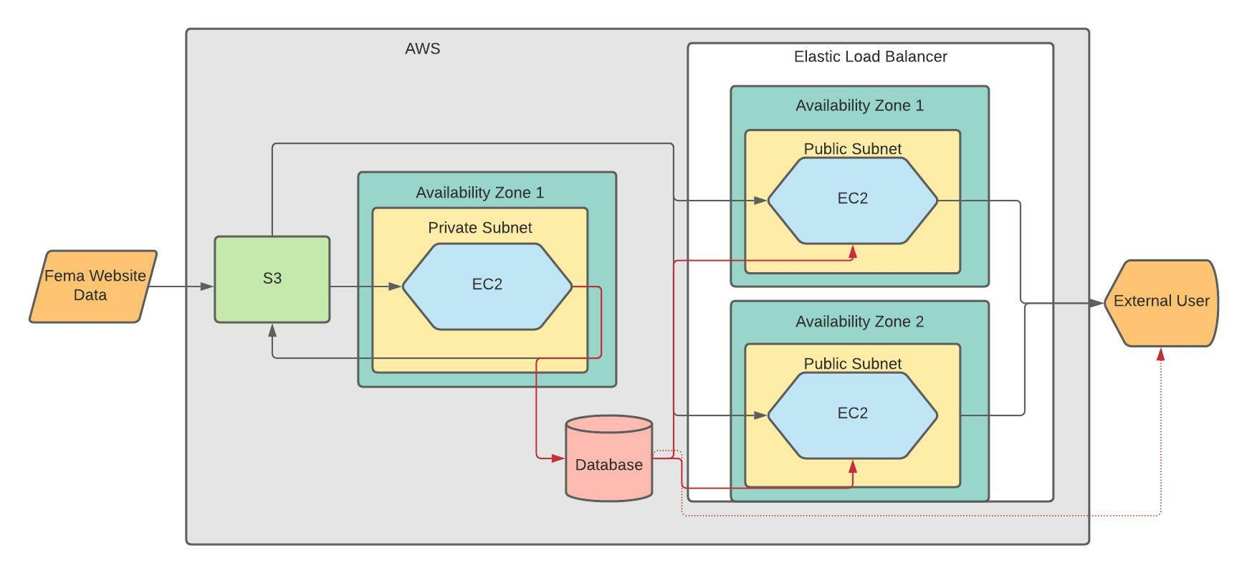
Data Flow

Slide 8
Implementation
S3: https://184975320928.signin.aws.amazon.com/console
EC2 Dashboard: https://184975320928.signin.aws.amazon.com/console
VPC: https://184975320928.signin.aws.amazon.com/console
Database
URL: http://ec2-3-237-106-43.compute-1.amazonaws.com/

Slide 9

Future Extensions
County/Zip Search Bar: Allow users of the website to search for their county/zip code directly instead of having to find it on the map
Leverage FEMA API: Use the FEMA API to automatically check for updates to the list and upload them as opposed to the current, manual process

Slide 10

Questions???
Thank you

Slide 11
References
https://commons.wikimedia.org/wiki/File:AWS_Simple_Icons_AWS_Cloud.svg
https://en.wikipedia.org/wiki/Amazon_Web_Services
http://harriscountycommunitycorner.org/2019/10/08/apply-now-for-fema-individual-assistance-for-imelda-recovery/
https://medium.com/featurepreneur/amazon-s3-101-f74ecc0c16e7
https://medium.com/geekculture/create-mysql-database-with-amazon-rds-4a6581e8dfaa
https://en.wikipedia.org/wiki/File:AWS_Simple_Icons_Networking_Amazon_Elastic_Load_Balancer.svg

